Slide 1
JPA Application Development & CRUD Operations

Slide 2
Objectives
Data Management
Implement CRUD (Create, Read, Update, Delete) operations to manage data effectively.
Utilize JPA to map Java objects to database tables, simplifying data persistence and retrieval.
User Interface Development
Design and develop a user-friendly interface using JavaFX, enabling seamless interaction with the application.
Implement features such as form input validation, error handling, and feedback mechanisms to enhance user experience.

Slide 3
Student Management System
Build Simple Student Management System
Step 1. Create Project in IntelliJ
Step 2. Setup Scene Builder
Step 3. Build CRUD Application with Repository Pattern
Step 4. Design GUI Application with JavaFX

Slide 4
Setup Scene Builder

Slide 5
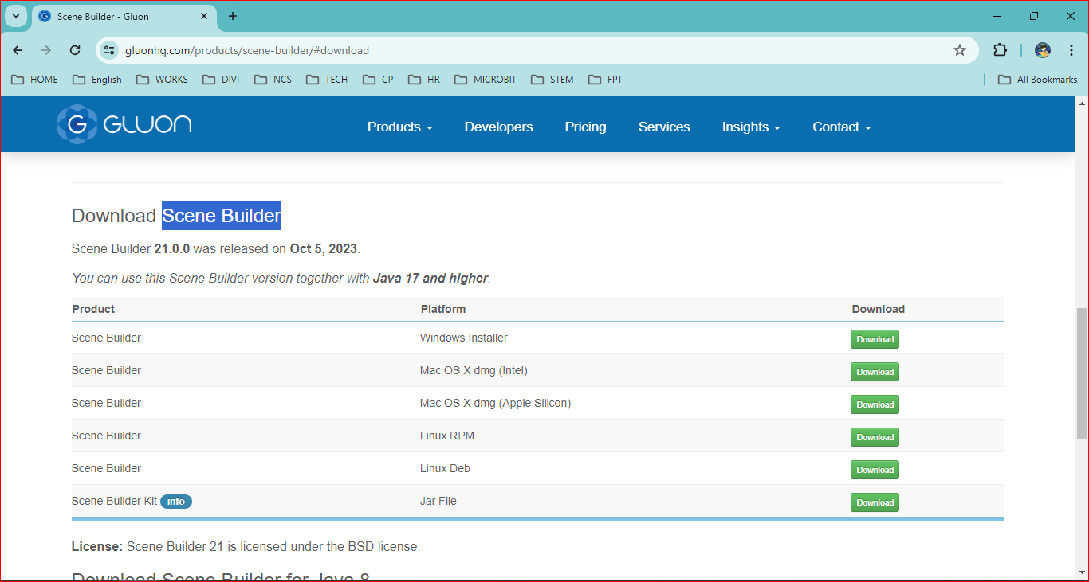
Go to website

Slide 6
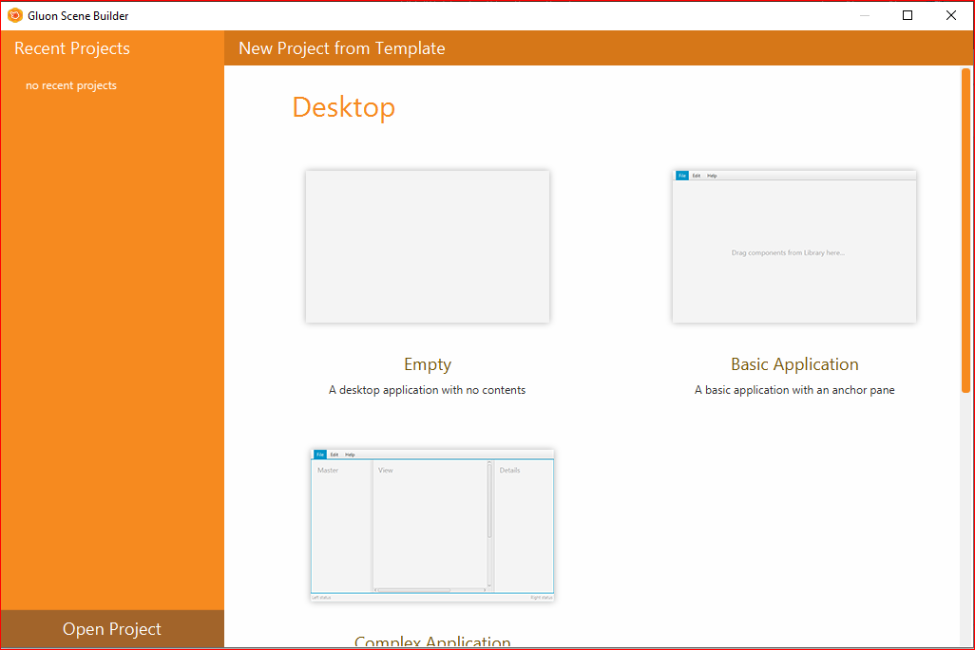
2. Open Gluon Scene Builder

Slide 7
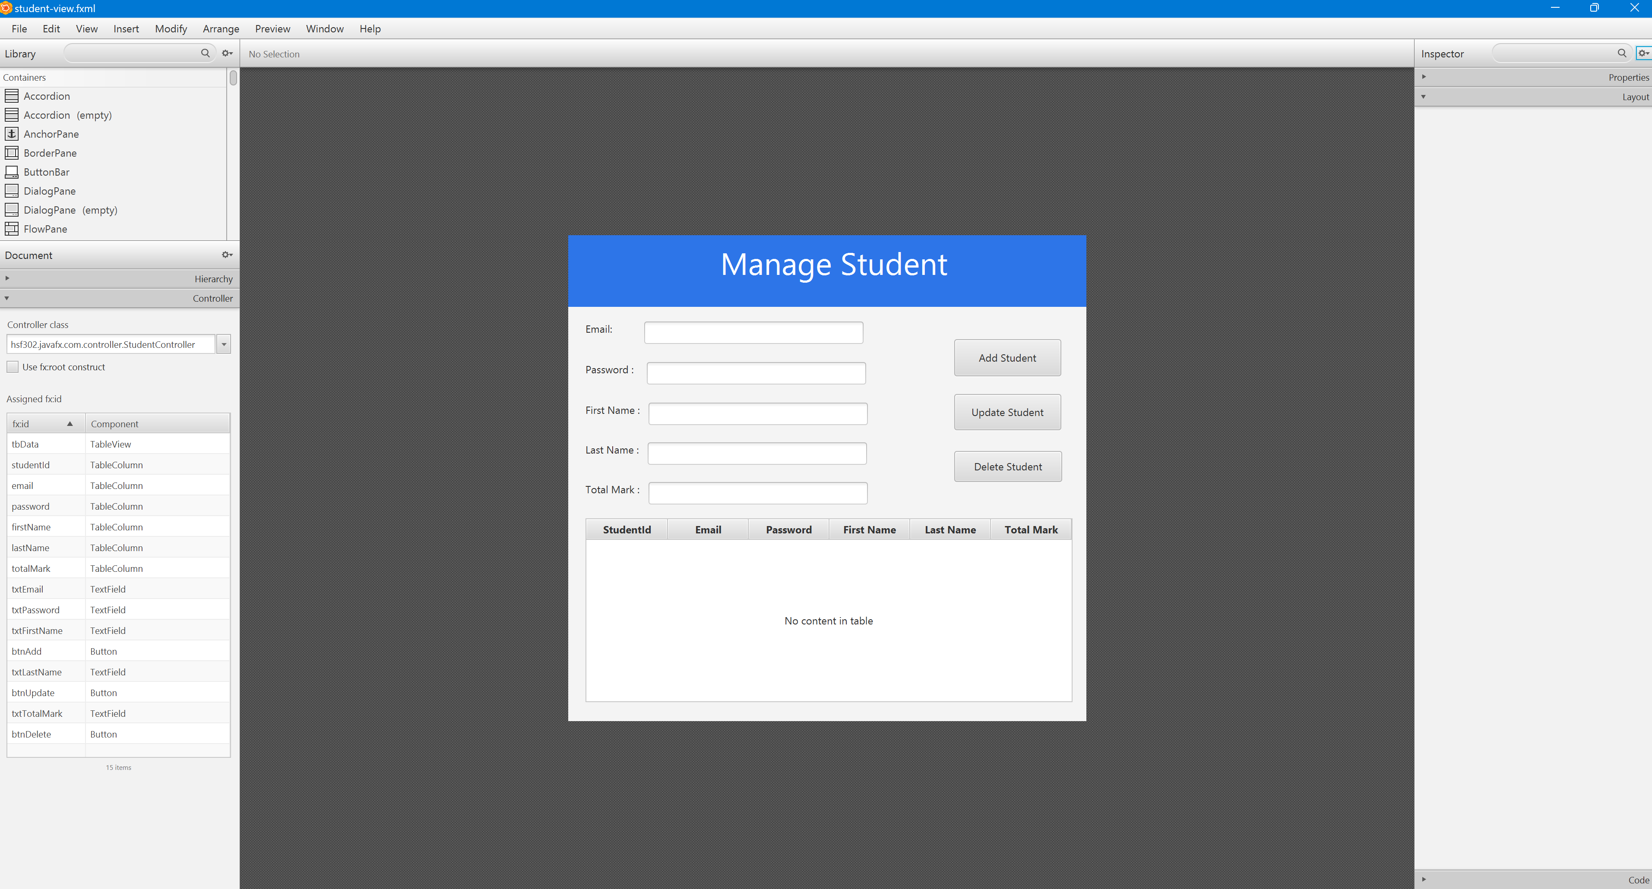
Open JavaFX File

Slide 8
Build CRUD Application with Repository Pattern

Slide 9
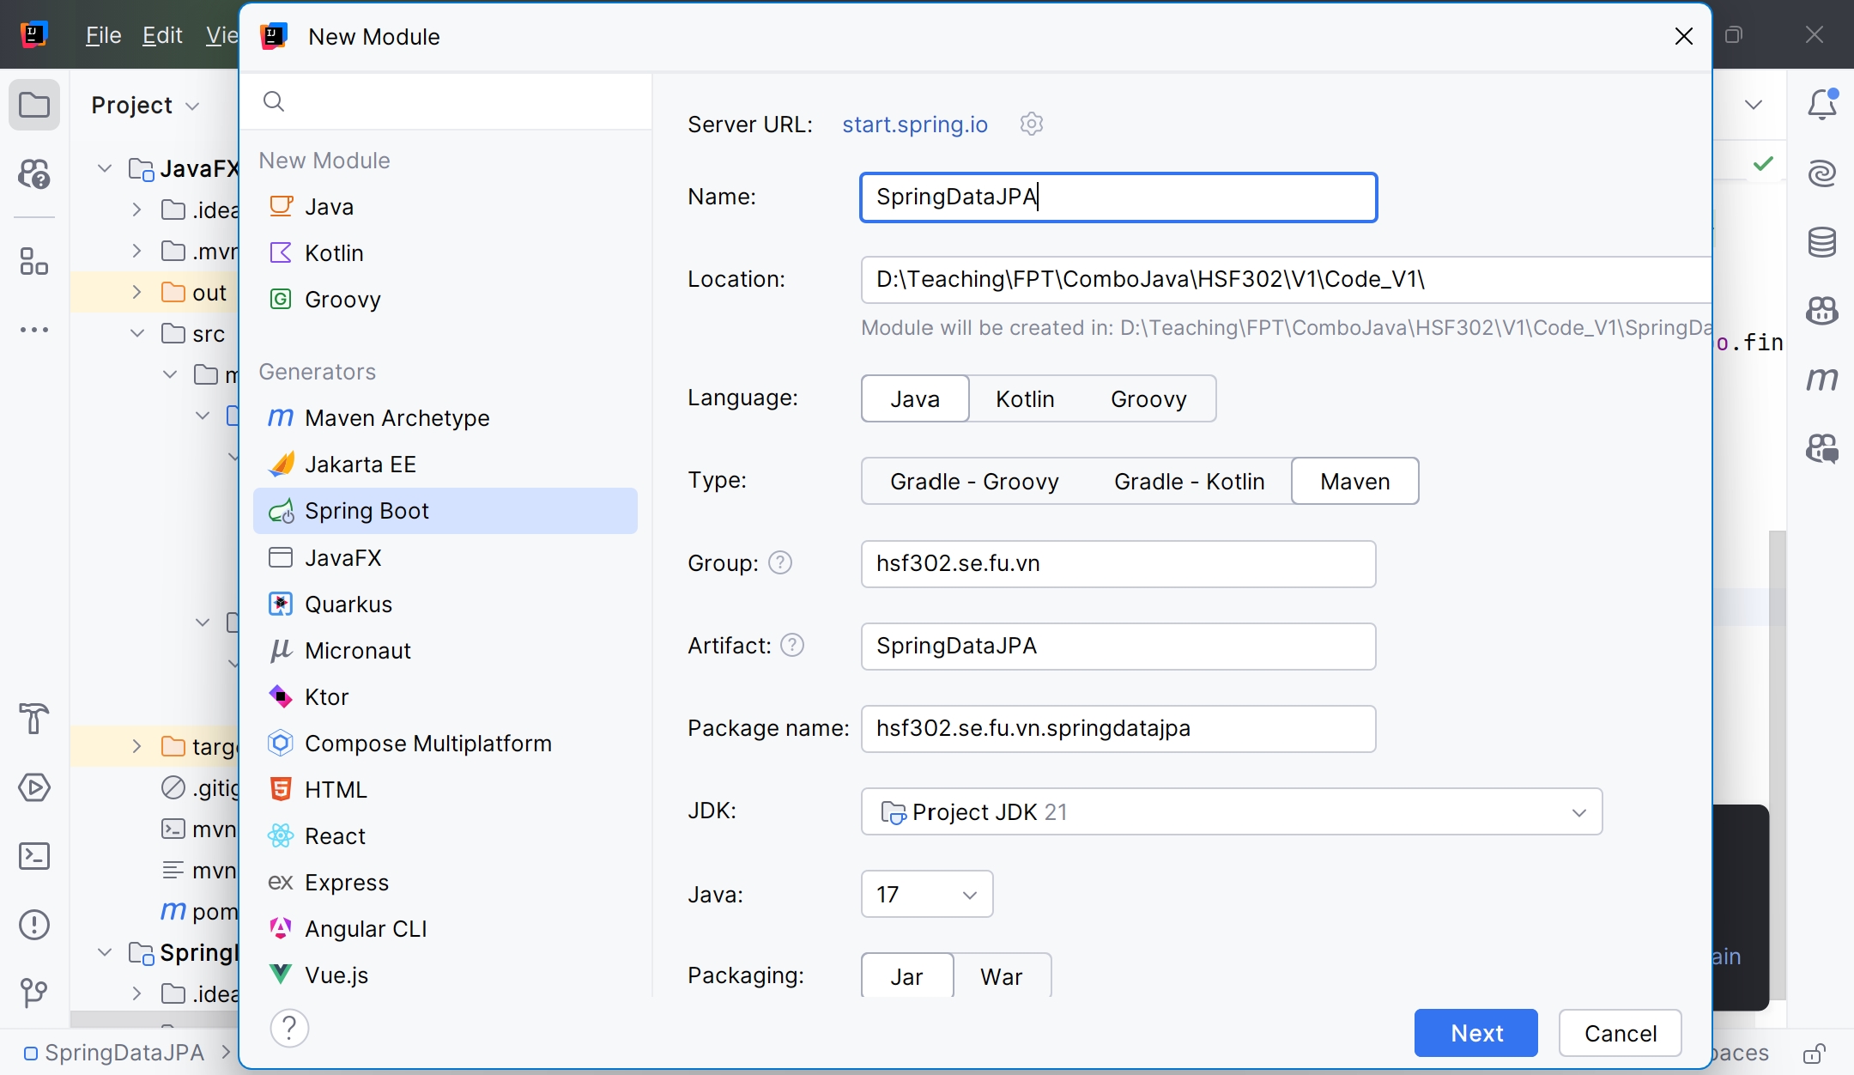
File -> New Module

Slide 10
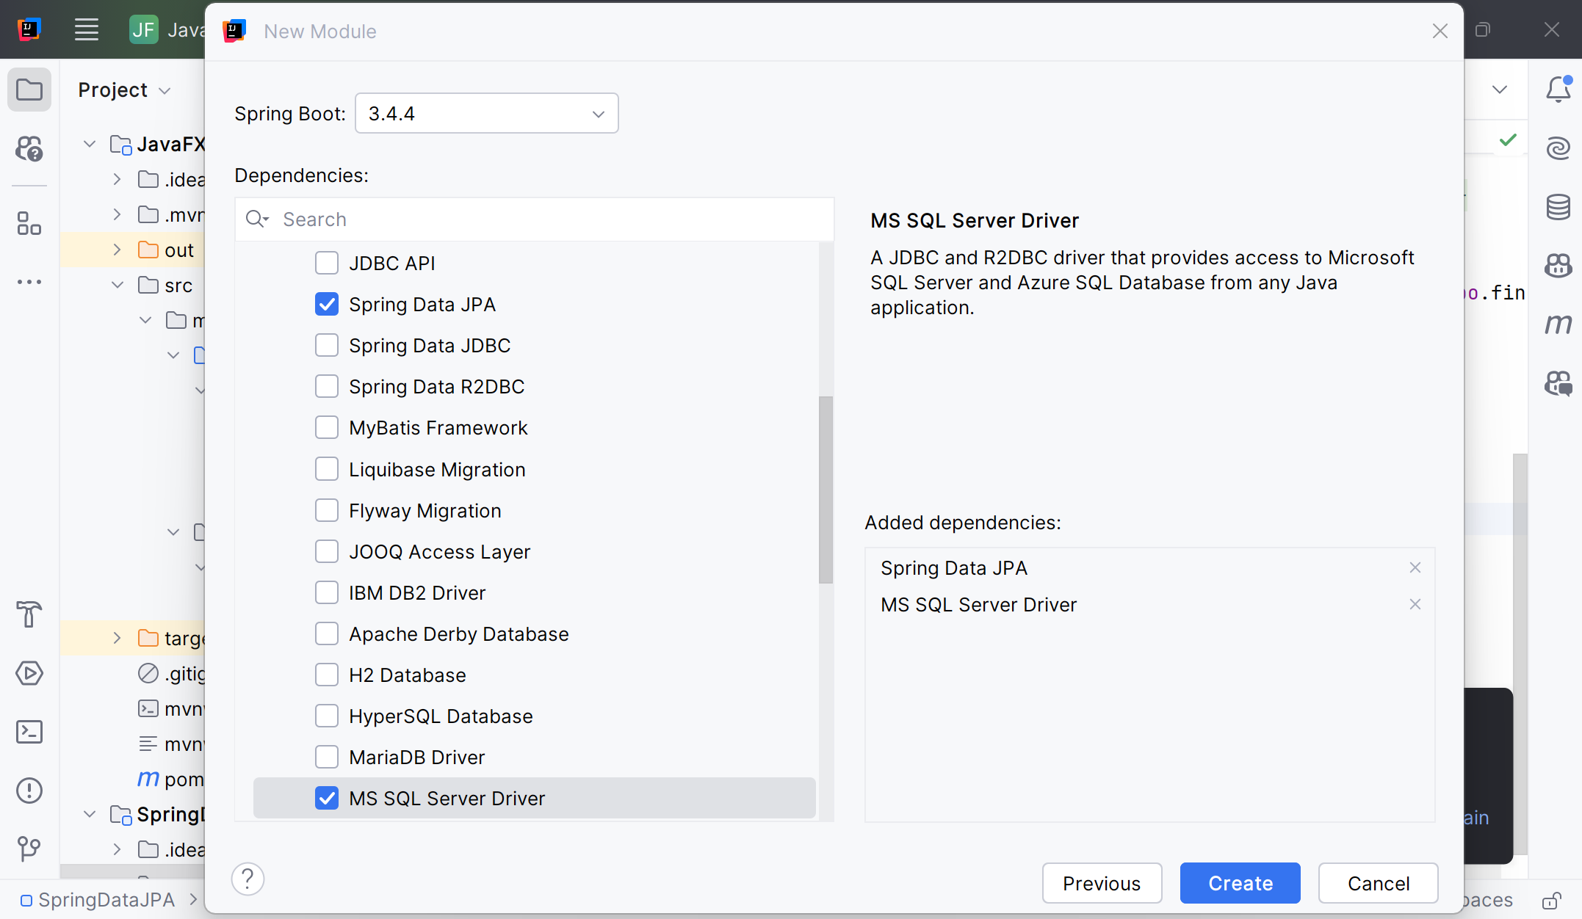
File -> New Module

Slide 11
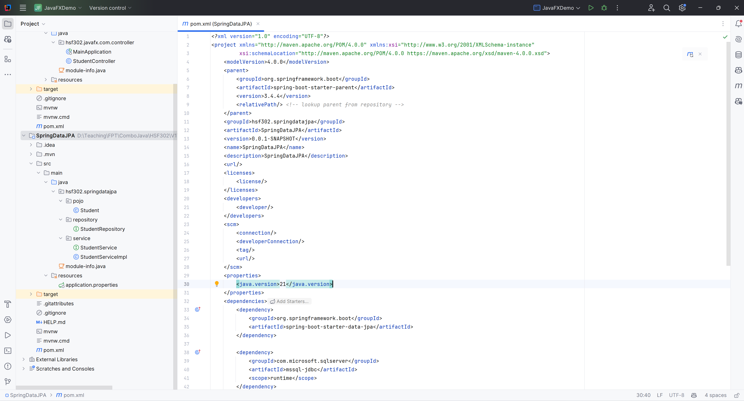
Create the Structure

Slide 12
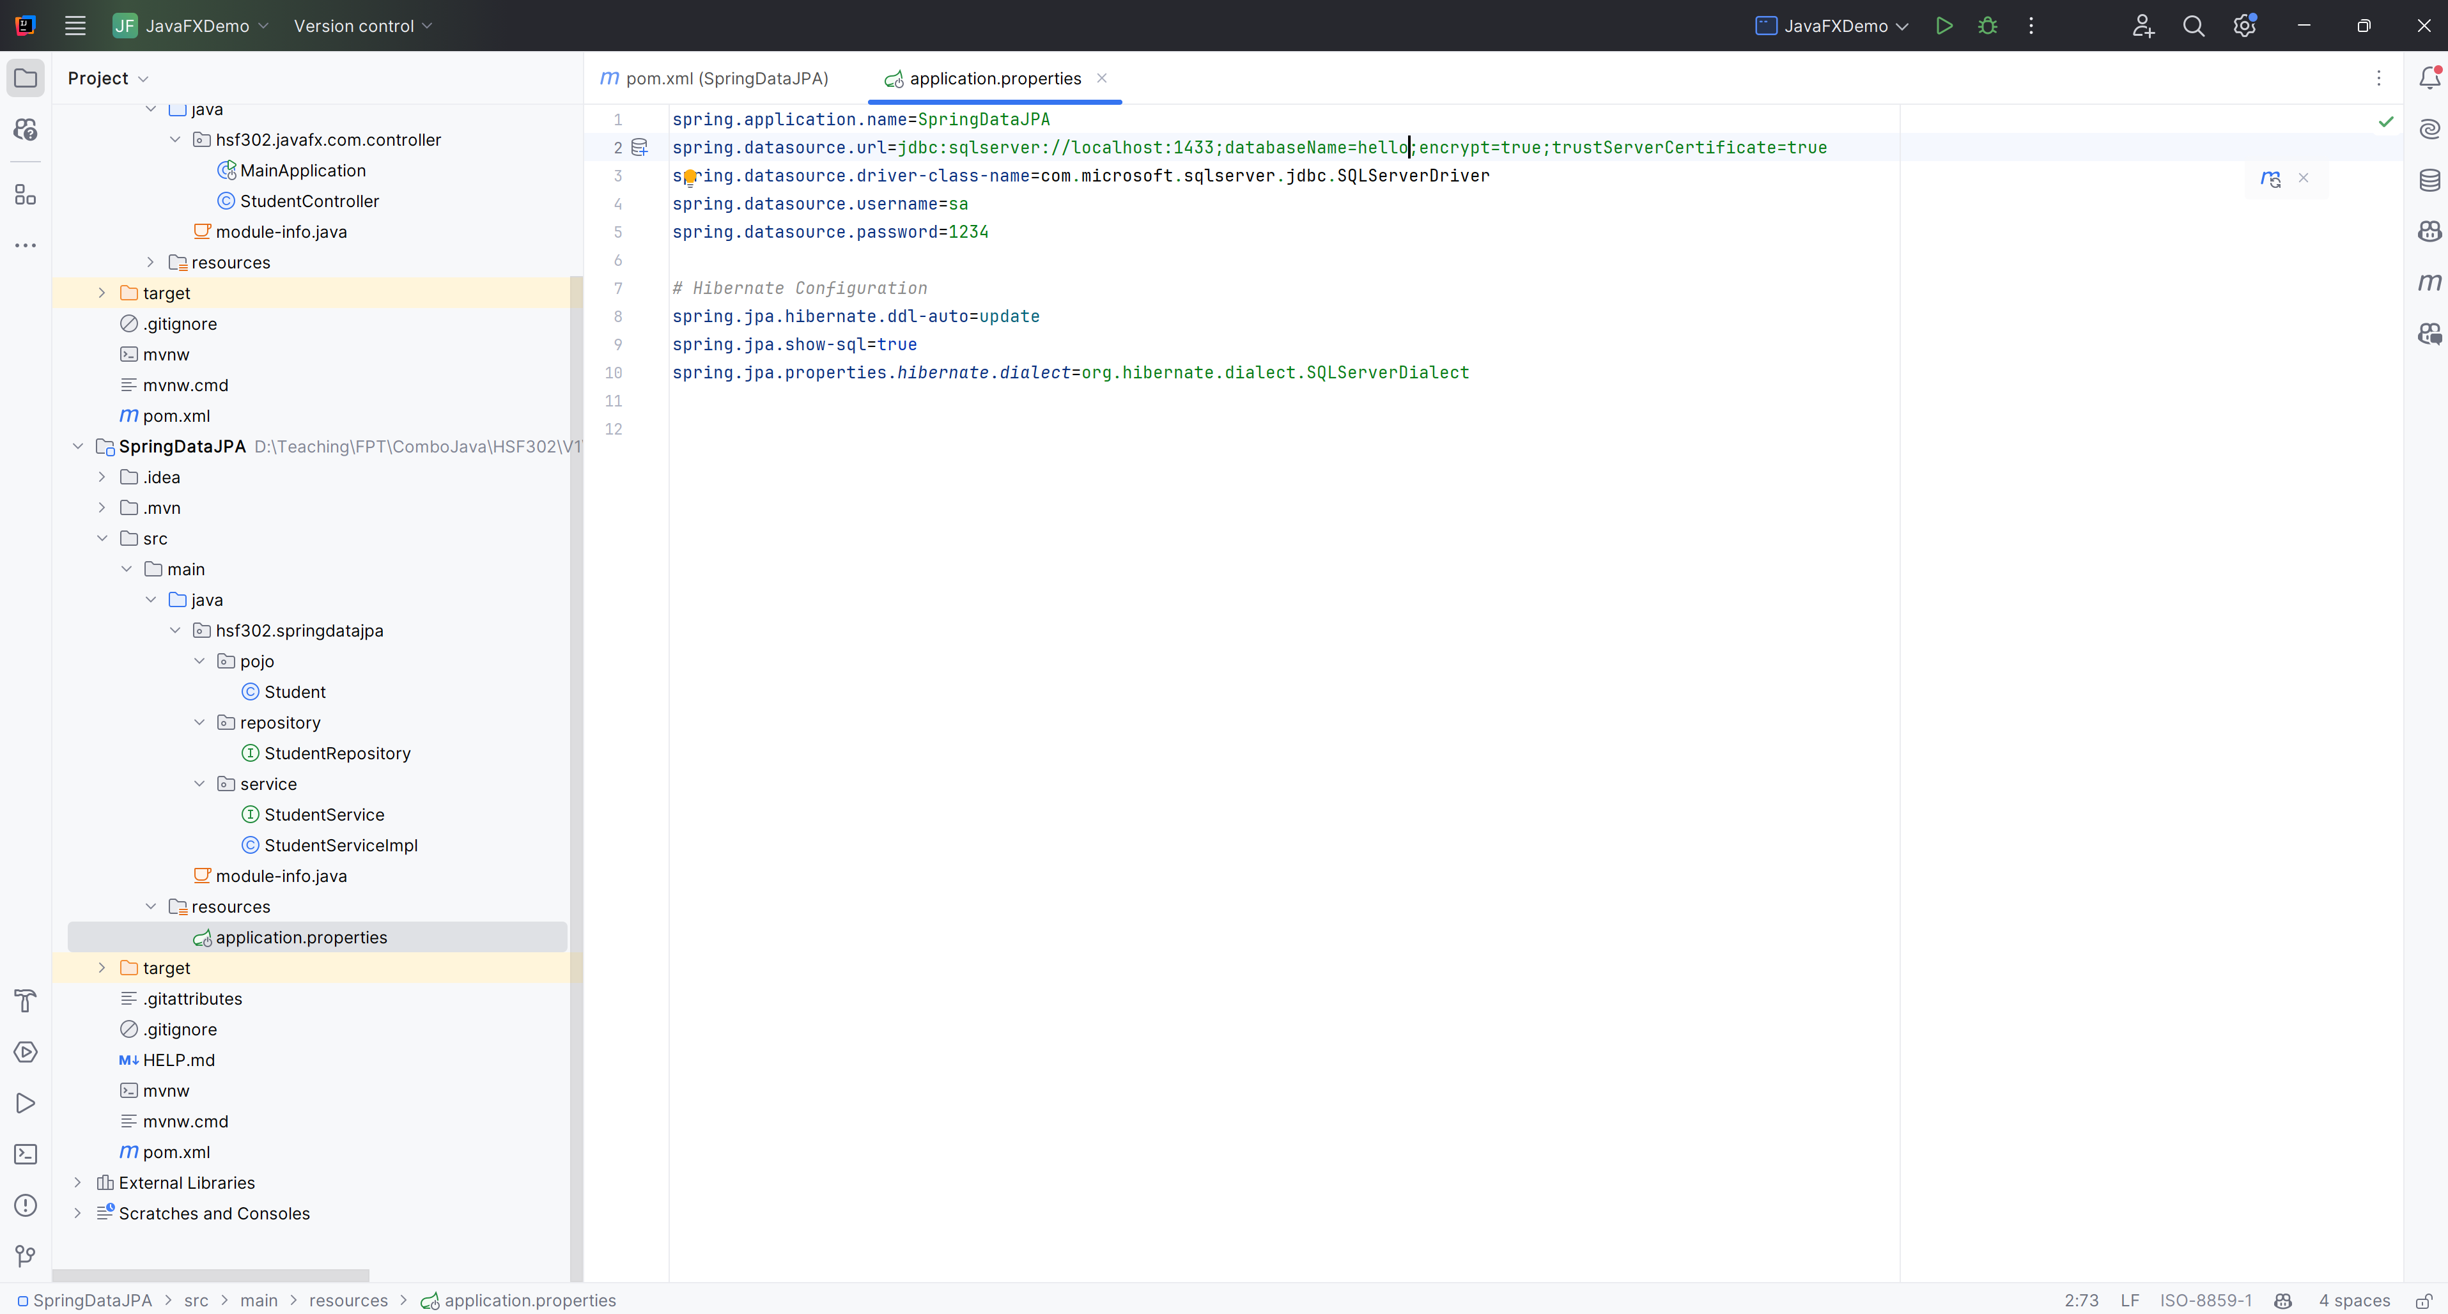
Update application.properties

Slide 13
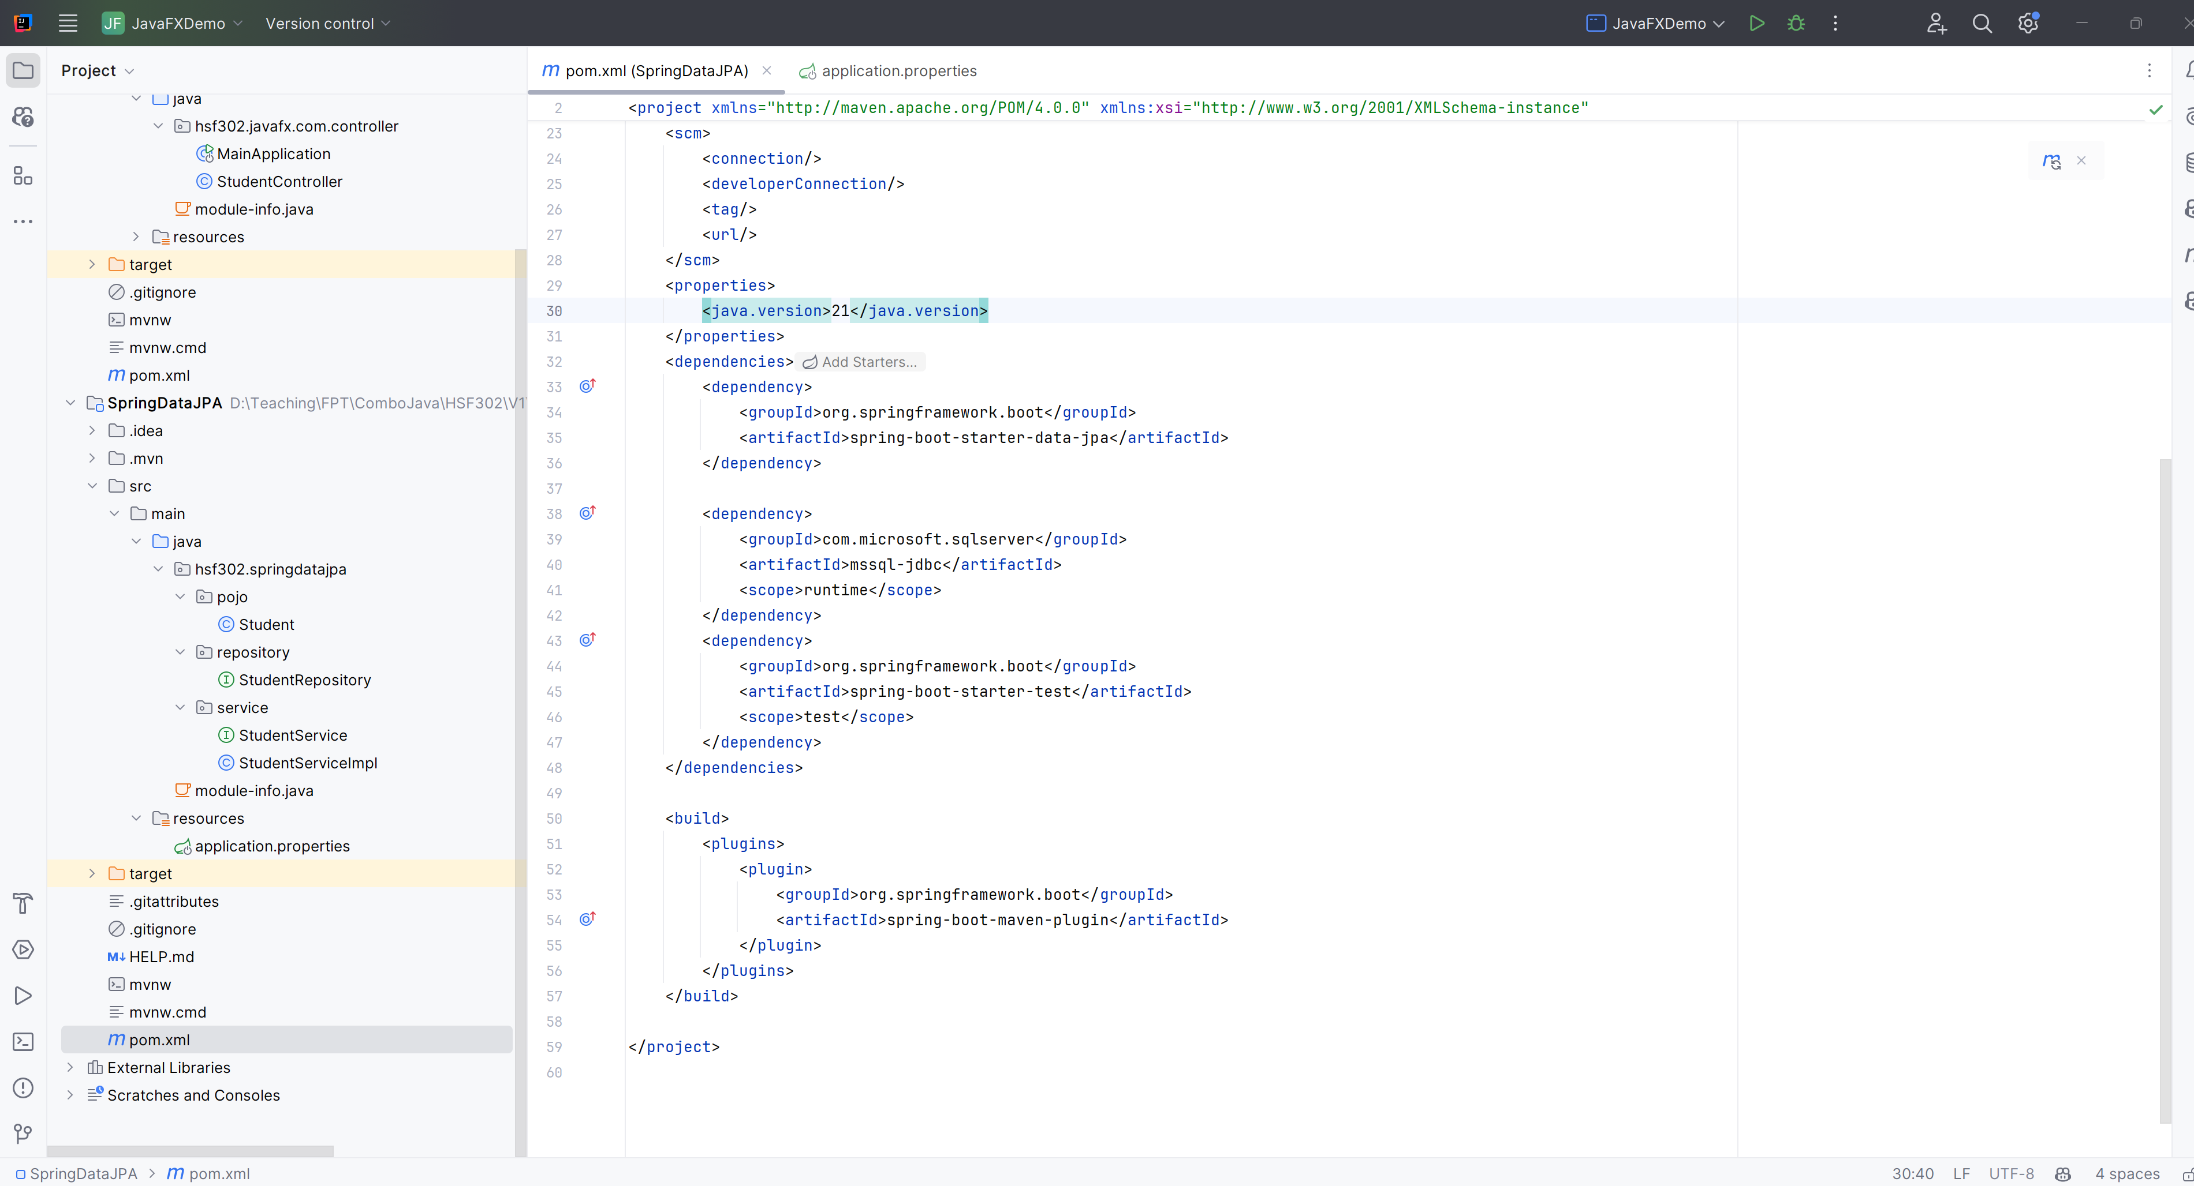
Update pom.xml

Slide 14
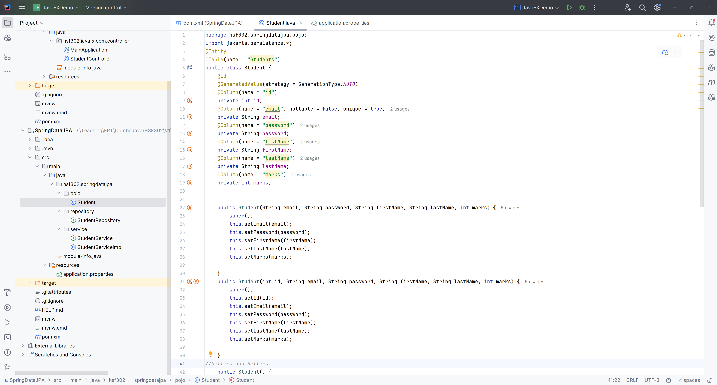
Create Student.java

Slide 15
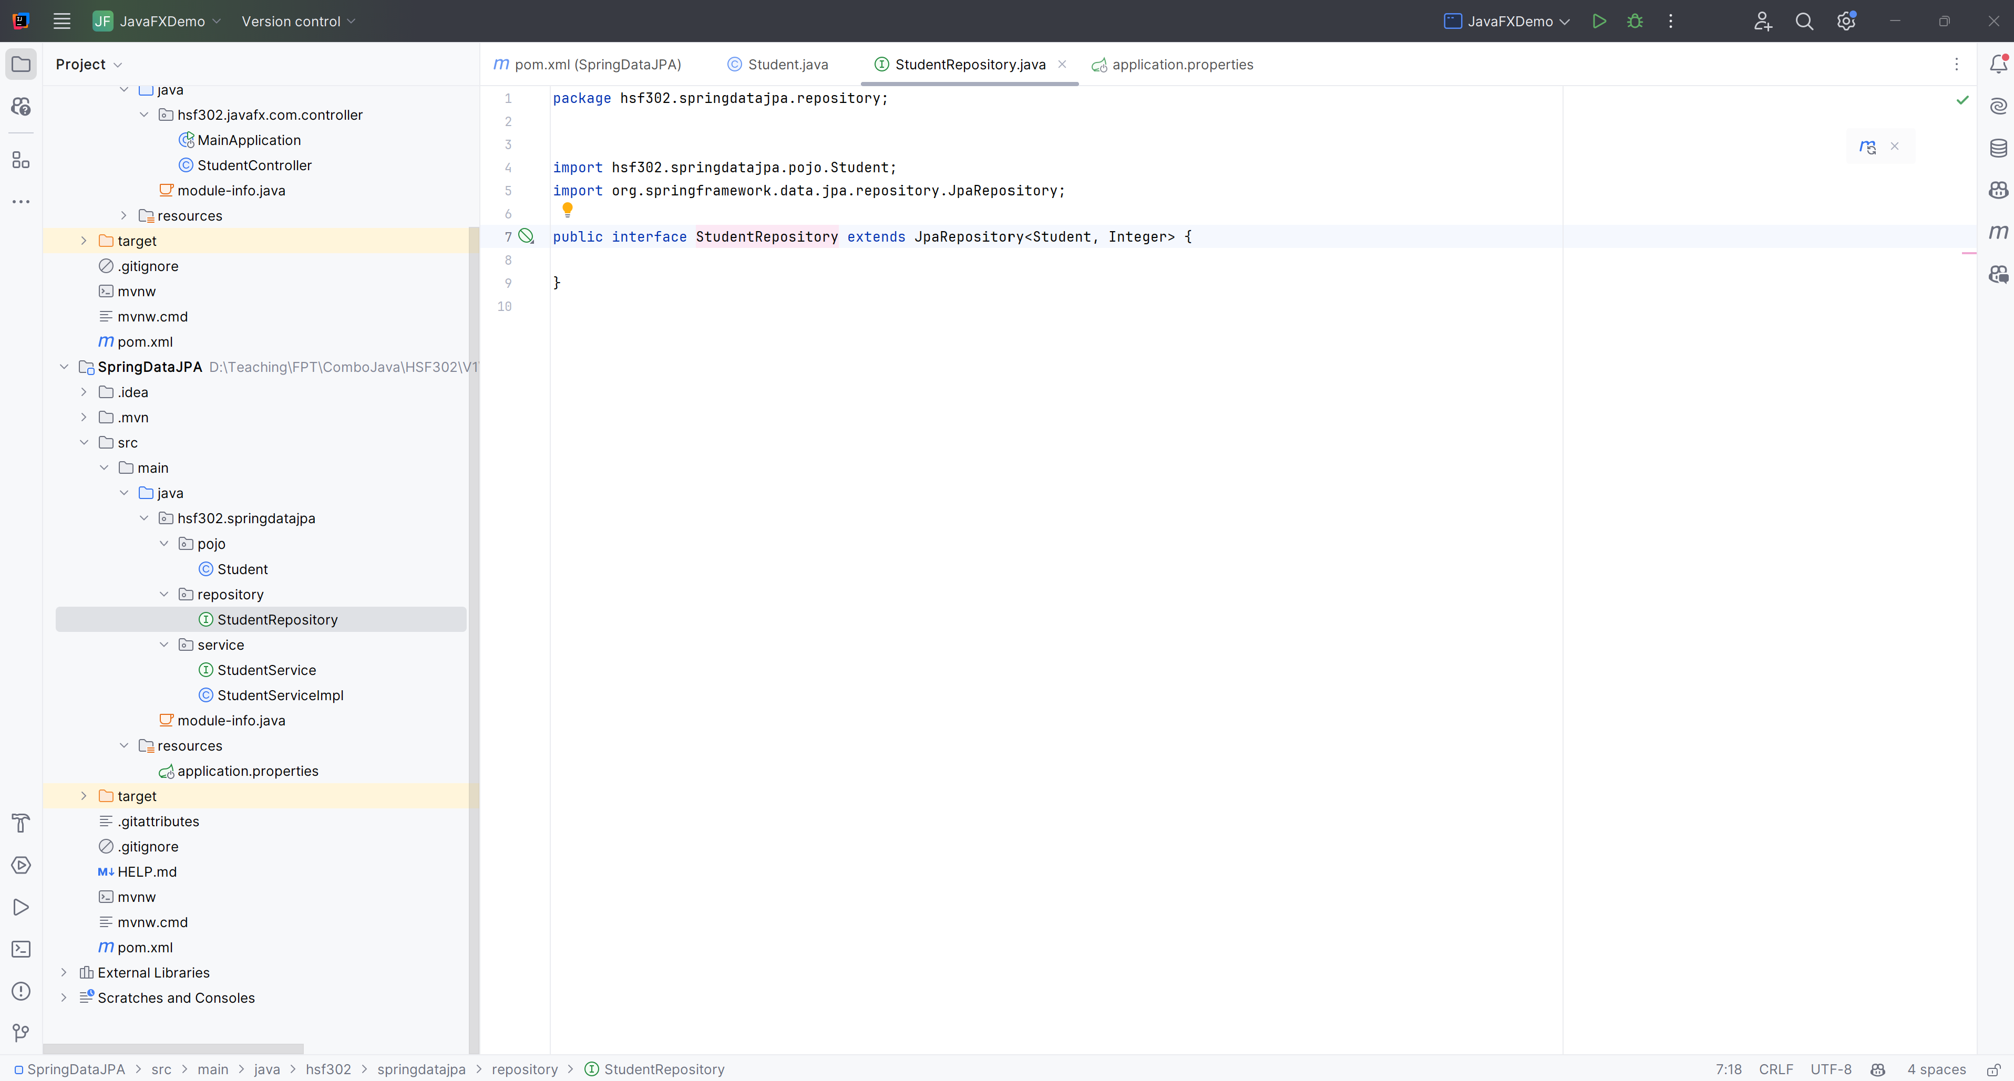
Create StudentRepository.java

Slide 16
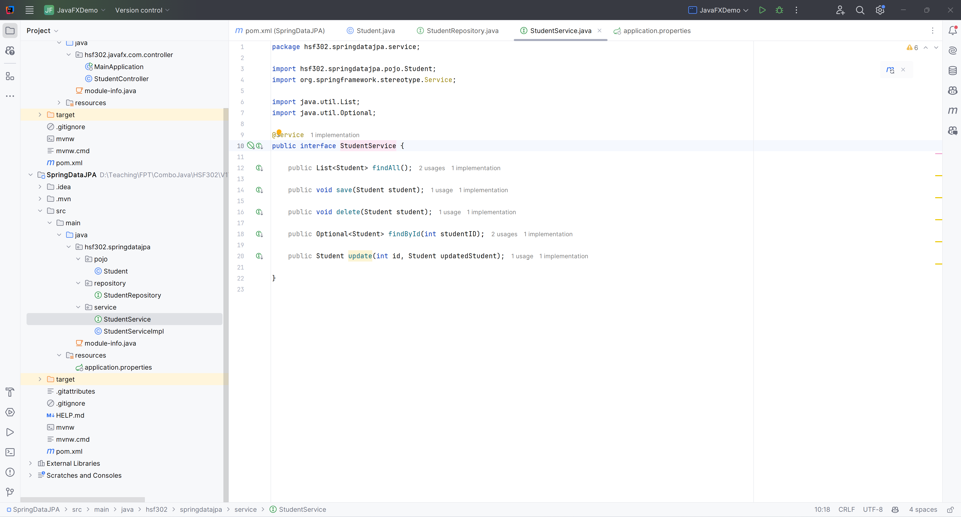
Create StudentService.java

Slide 17
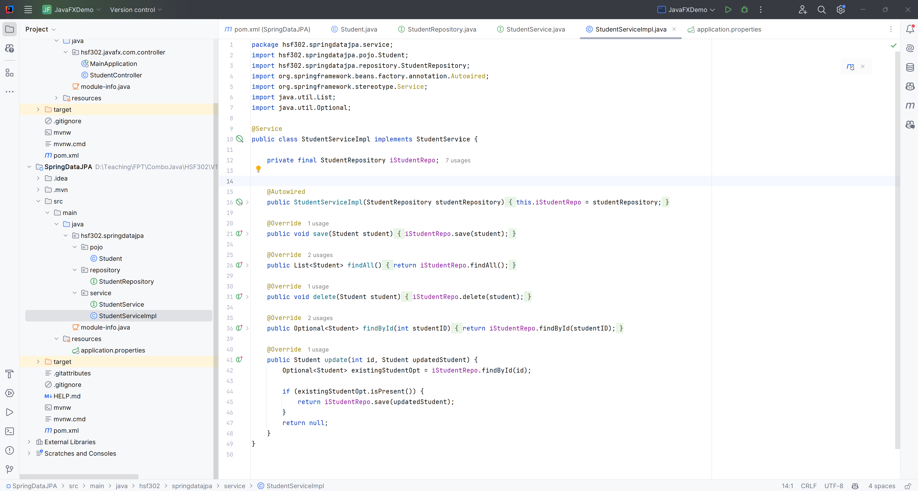
Create StudentServiceImpl.java

Slide 18
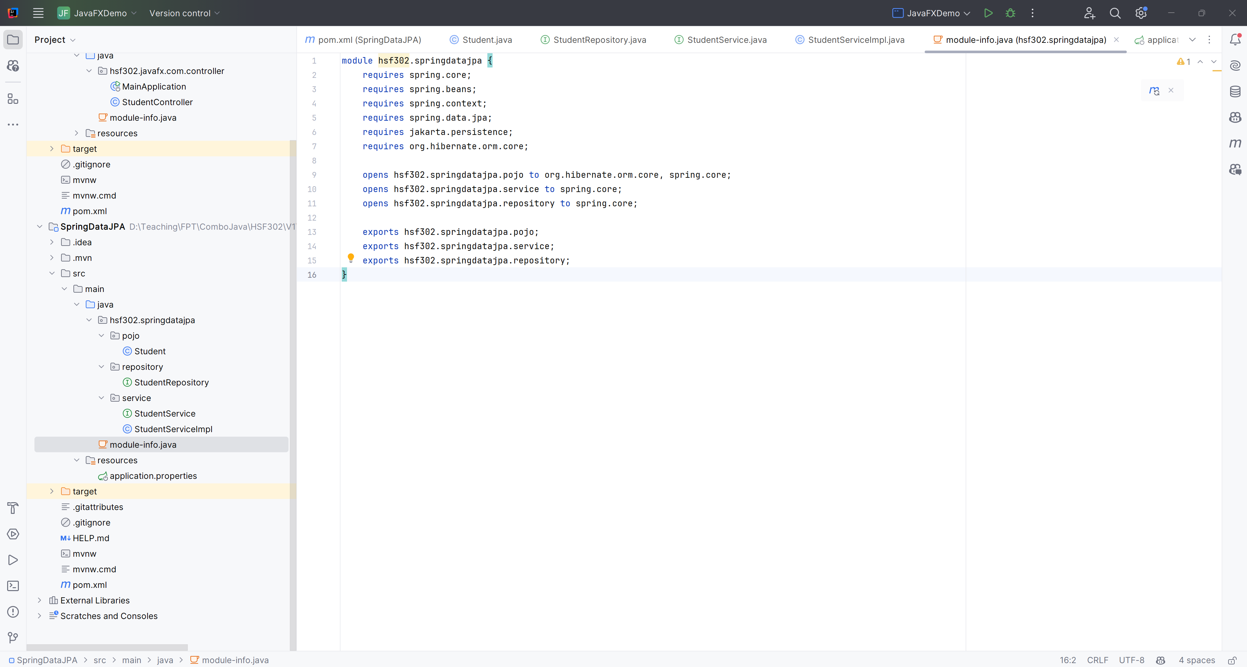
Create module-info.java

Slide 19
Design GUI Application with JavaFX

Slide 20
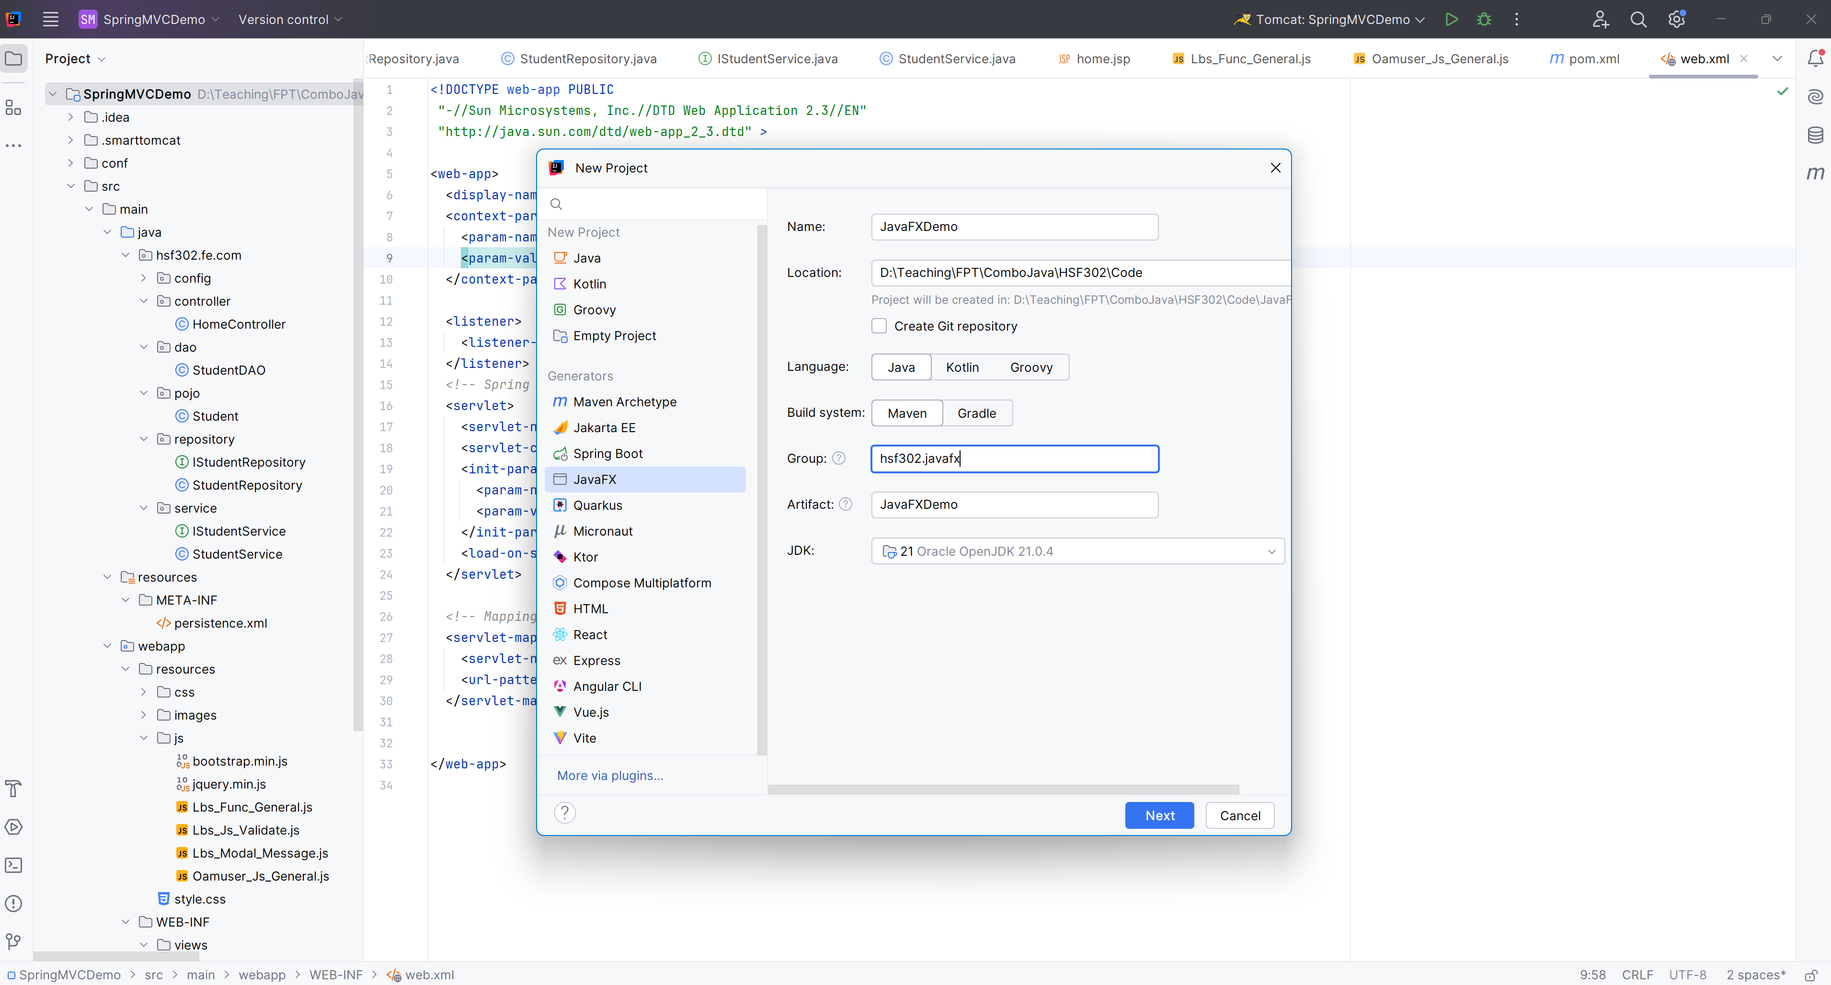
Open IntelliJ, File | New | Maven Project

Slide 21
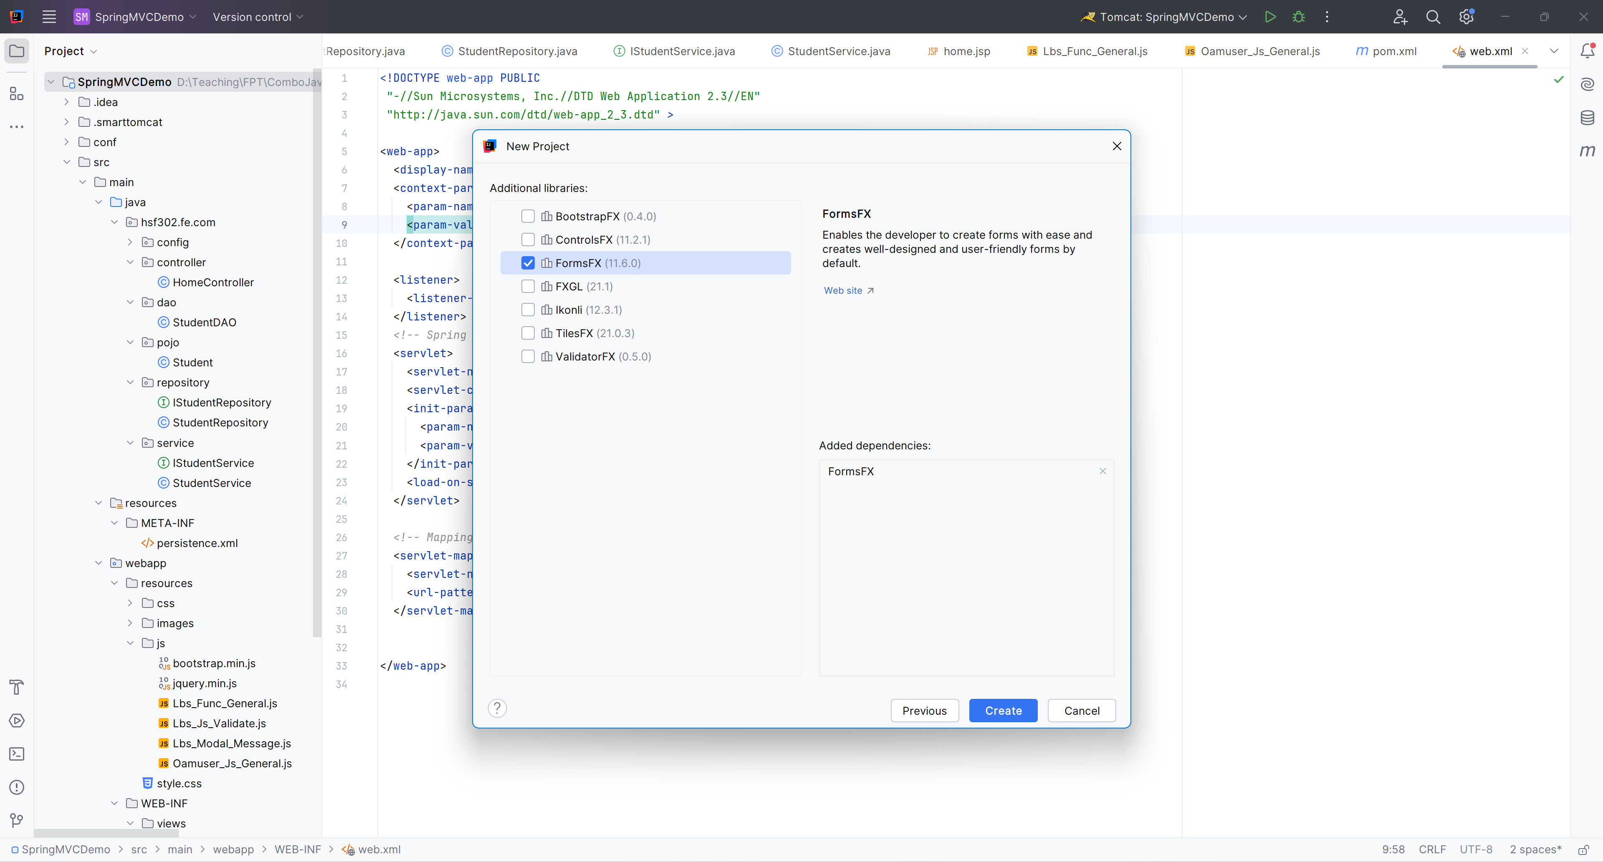
Check FormFX

Slide 22
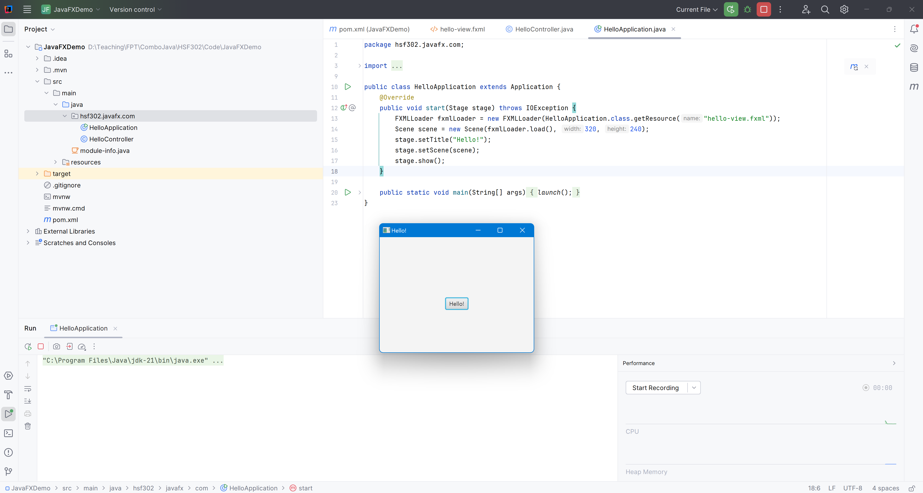
Run Project

Slide 23
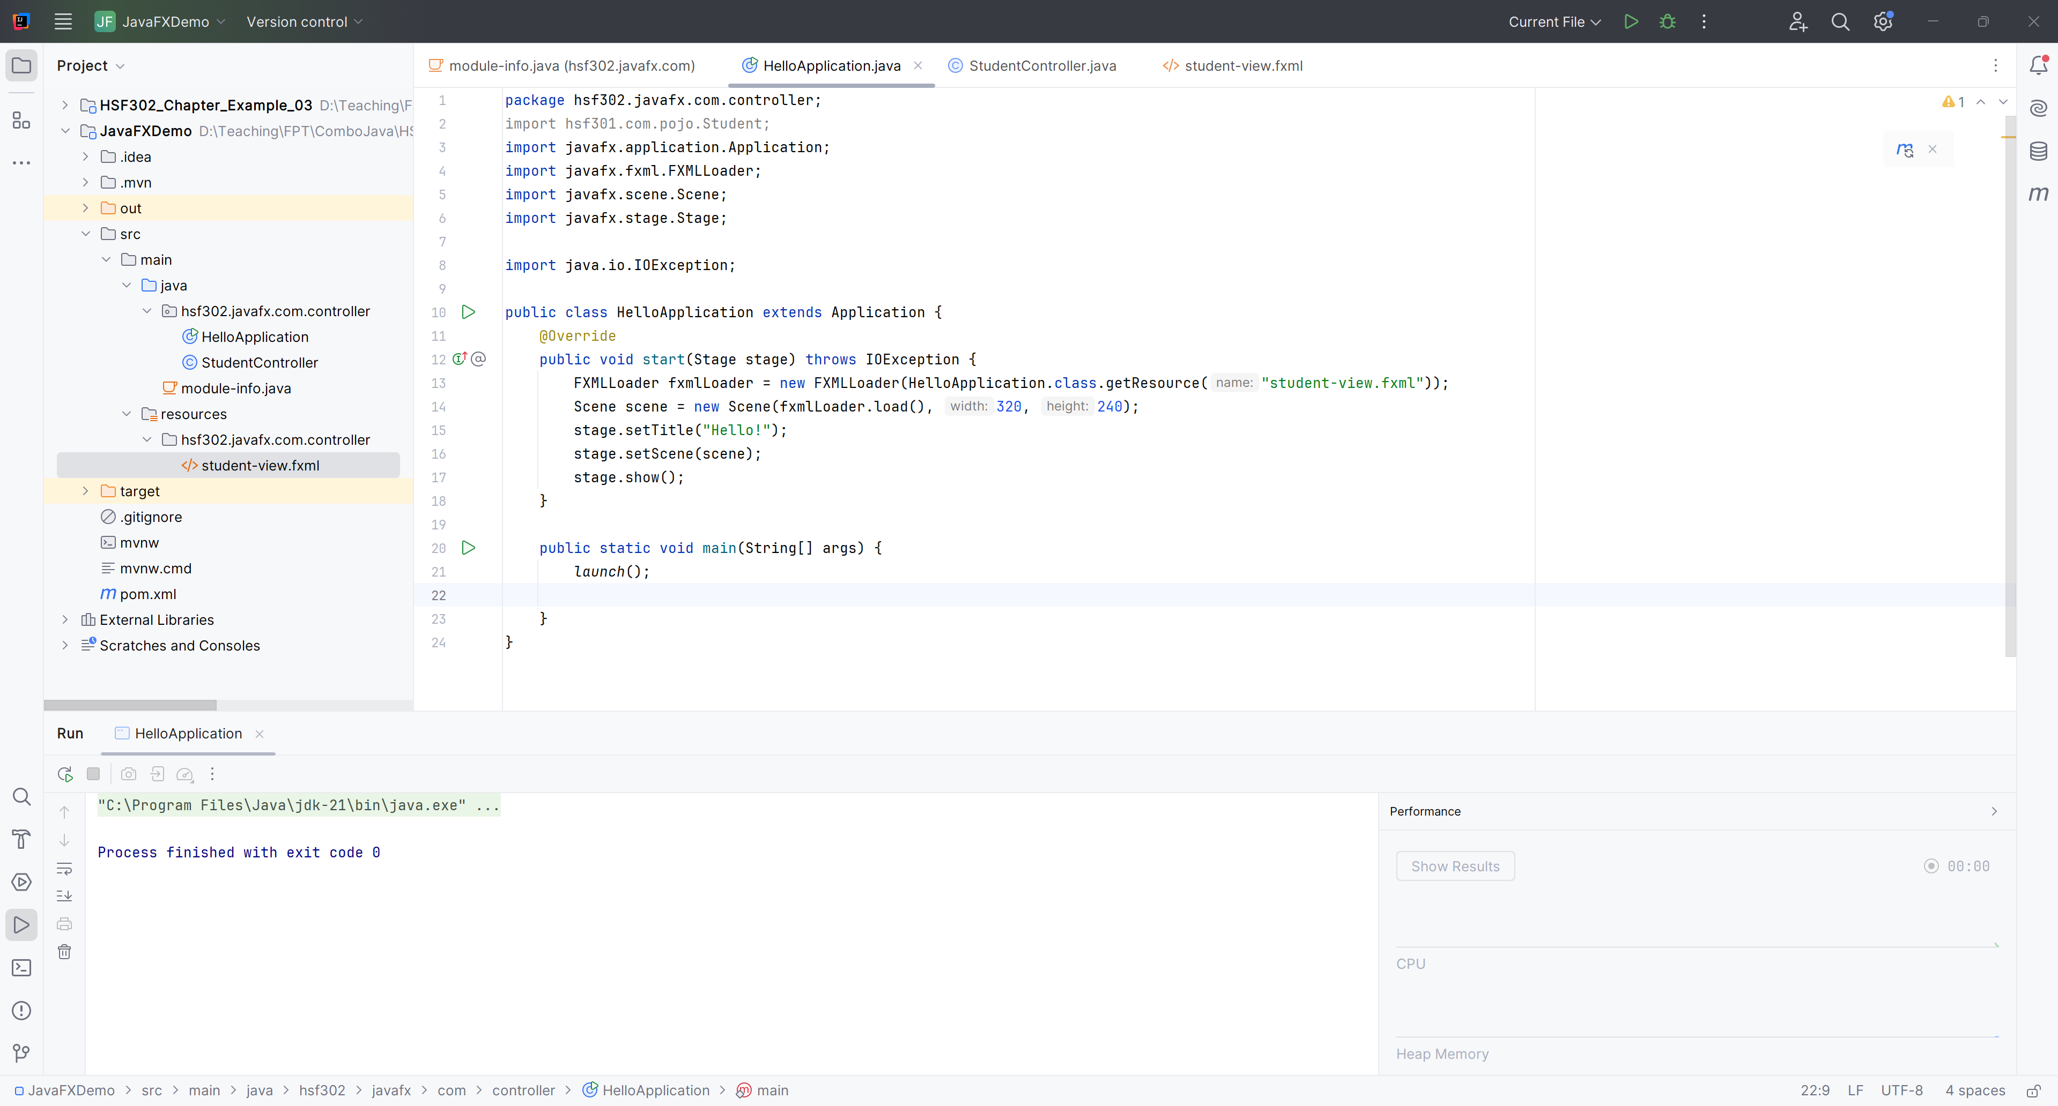
Build the Architecture

Slide 24
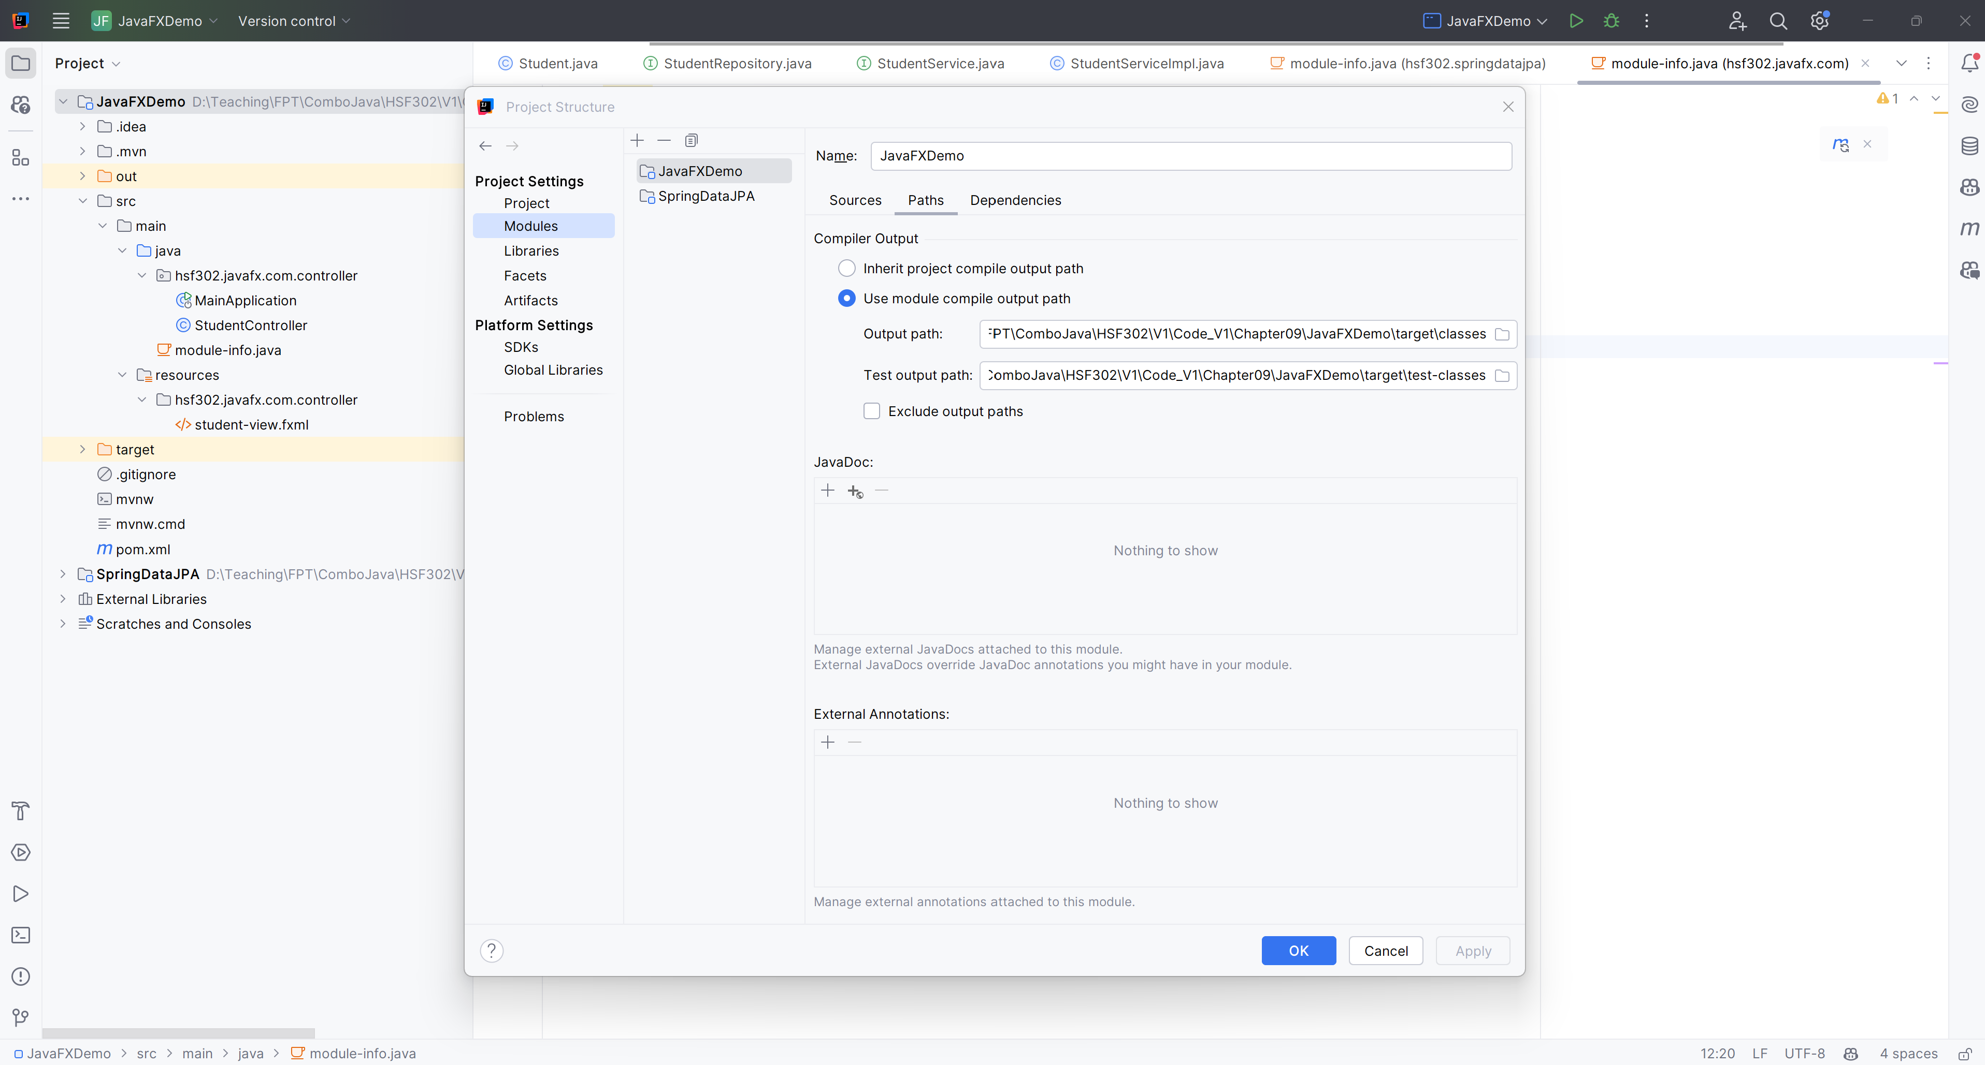
Add Reference Another Project

Slide 25
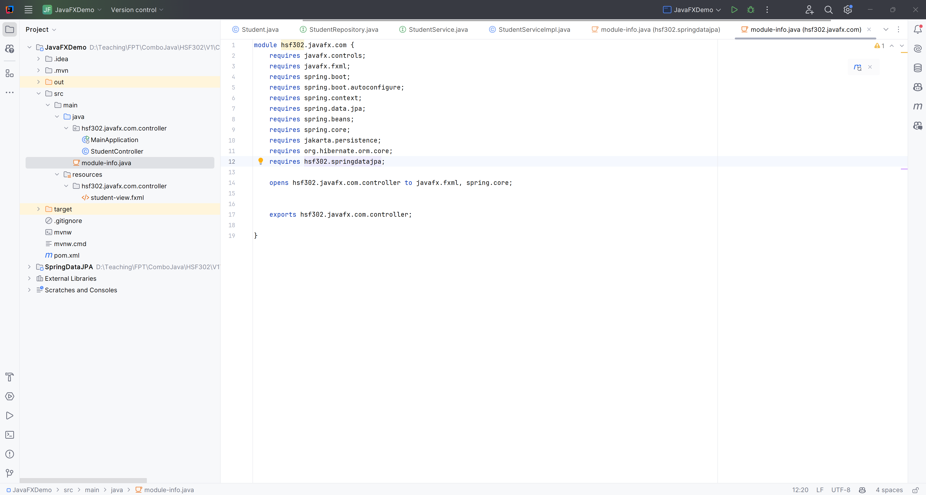
Edit module-info.java in JavaFXDemo

Slide 26
Open Student-view.fxml in SceneBuilder

Slide 27
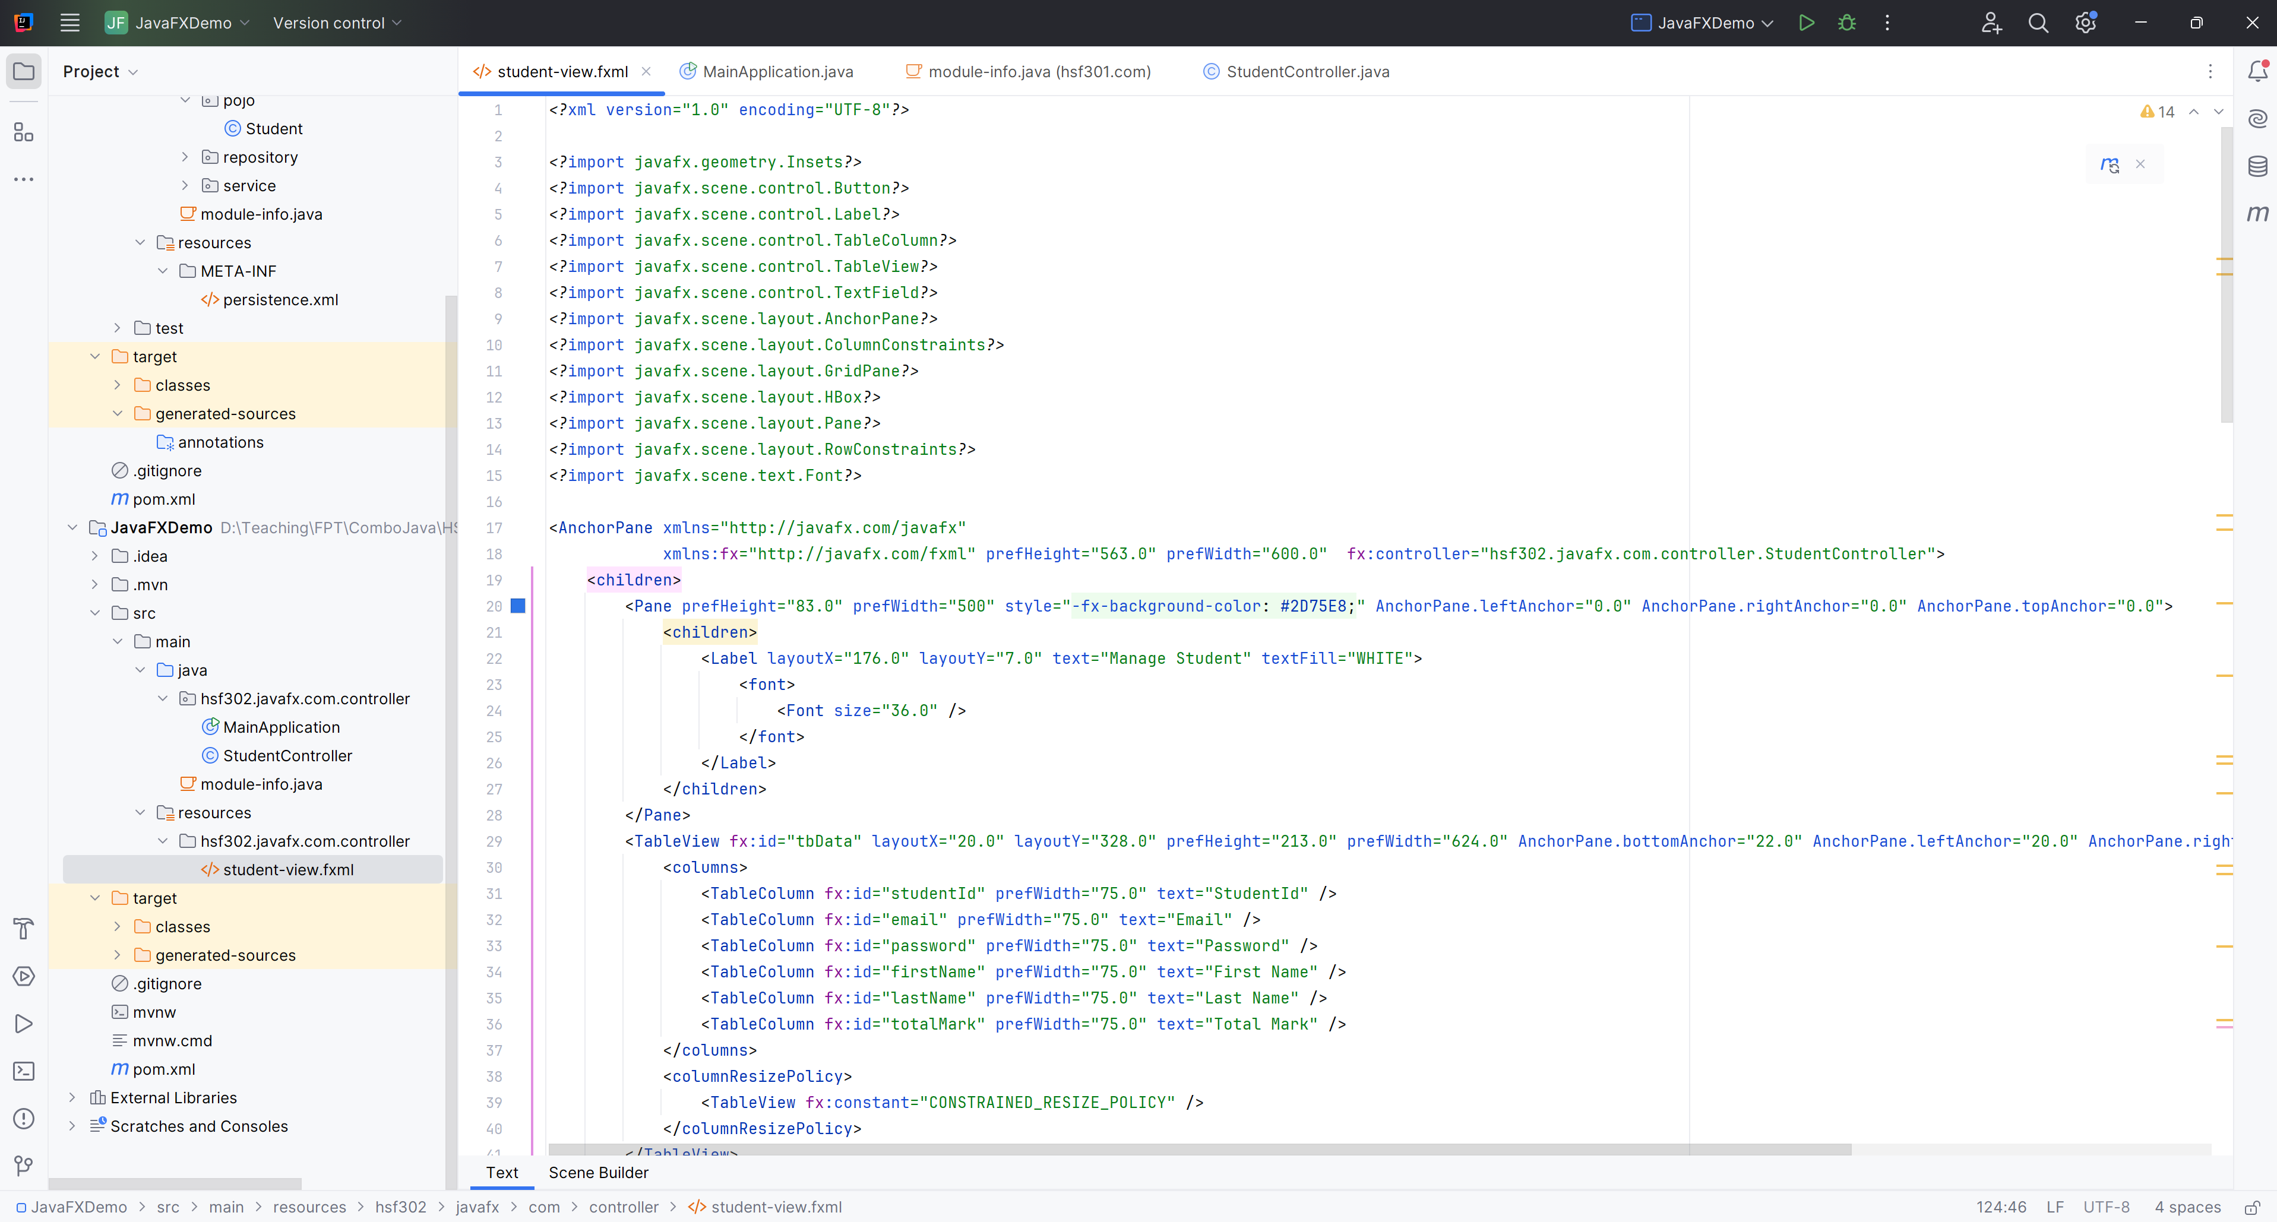
Edit student-view.fxml

Slide 28
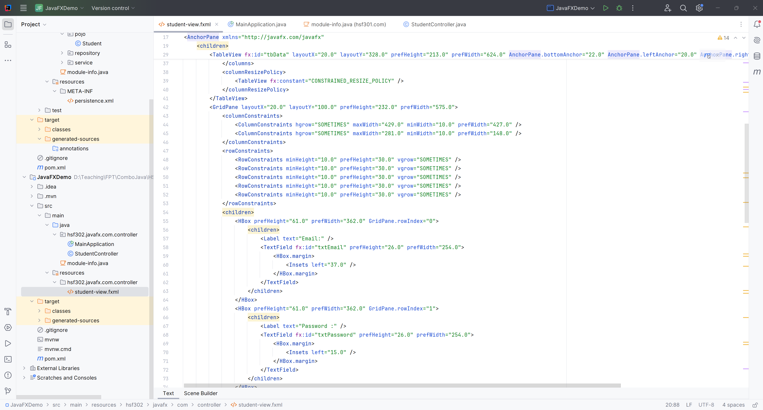
Edit student-view.fxml

Slide 29
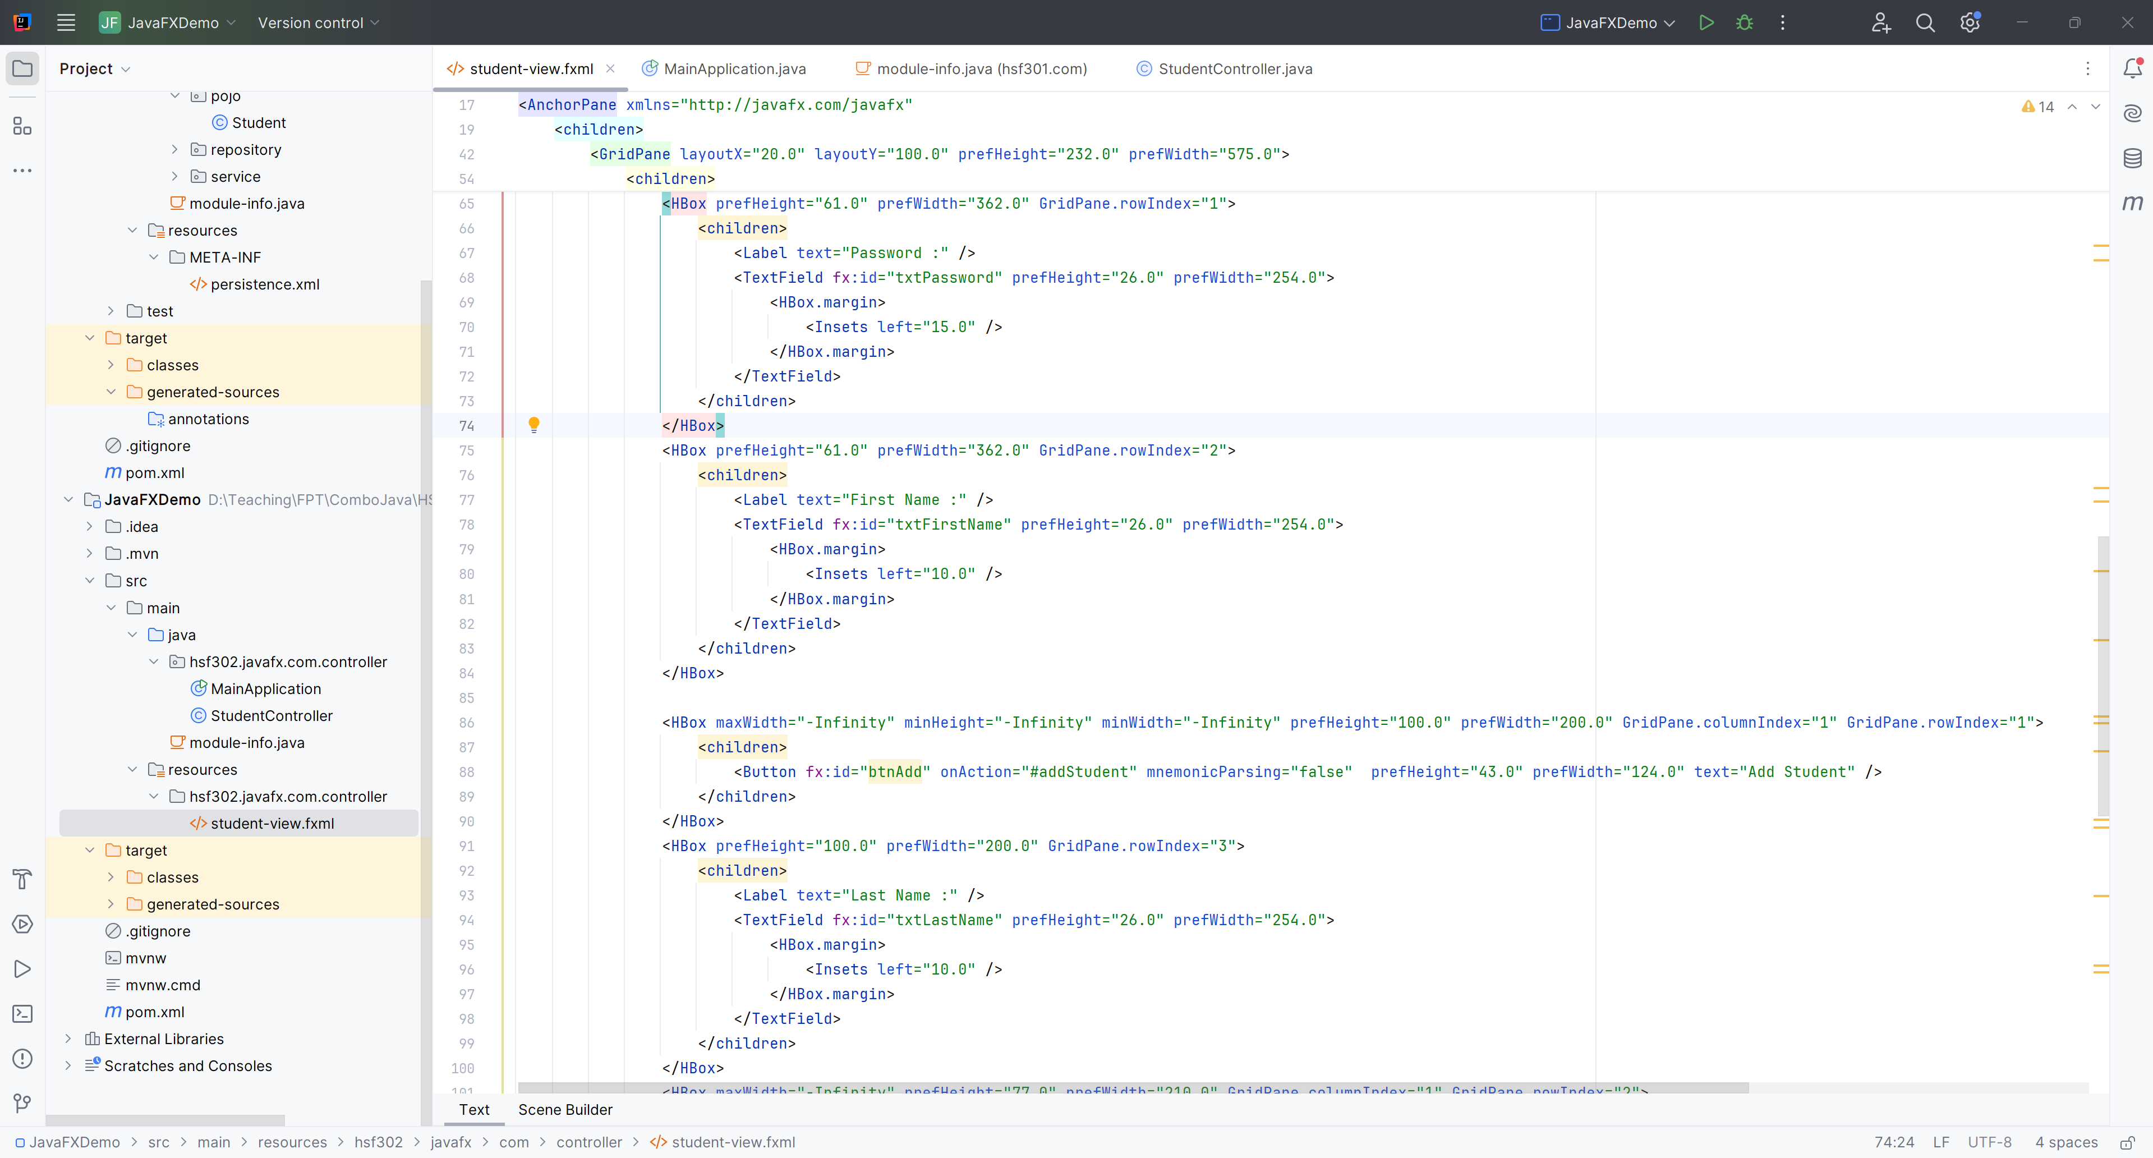
Edit student-view.fxml

Slide 30
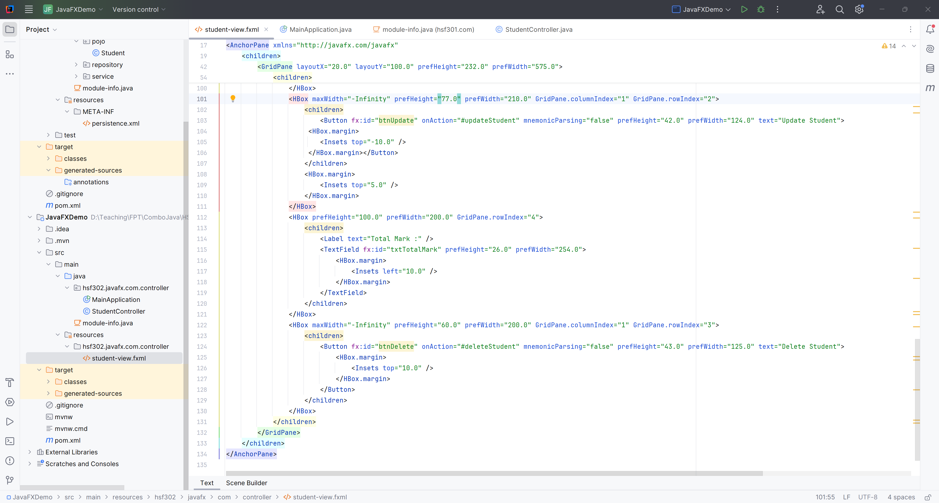
Edit student-view.fxml

Slide 31
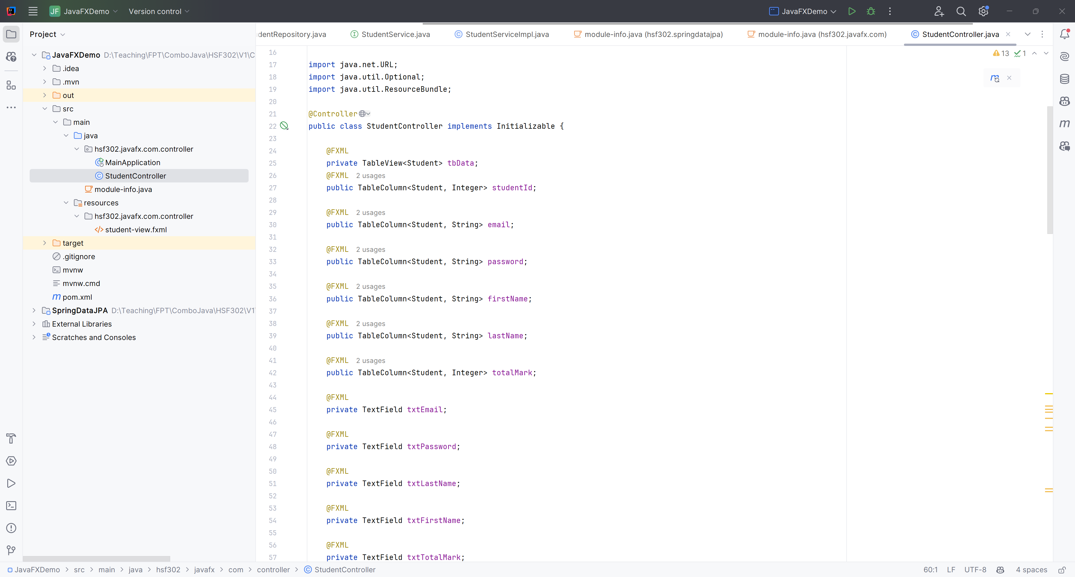
Edit the StudentController.java

Slide 32
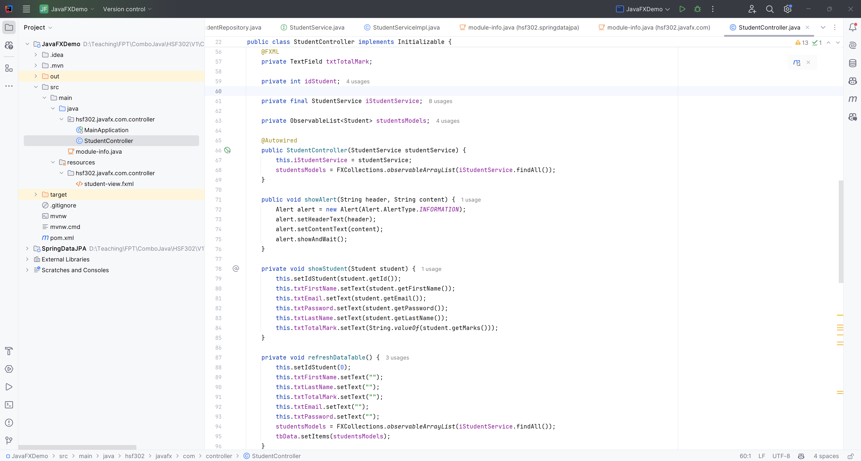
Edit the StudentController.java

Slide 33
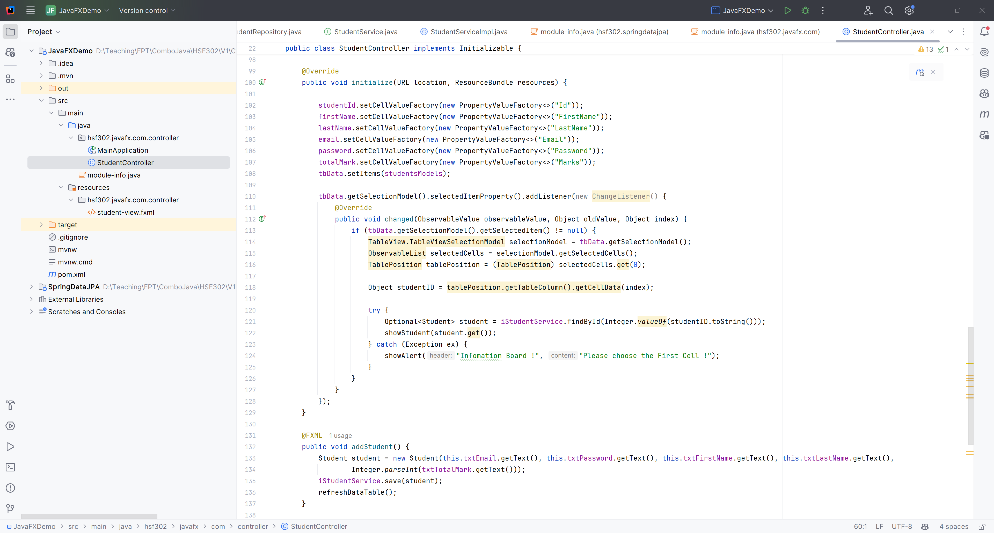
Edit the StudentController.java

Slide 34
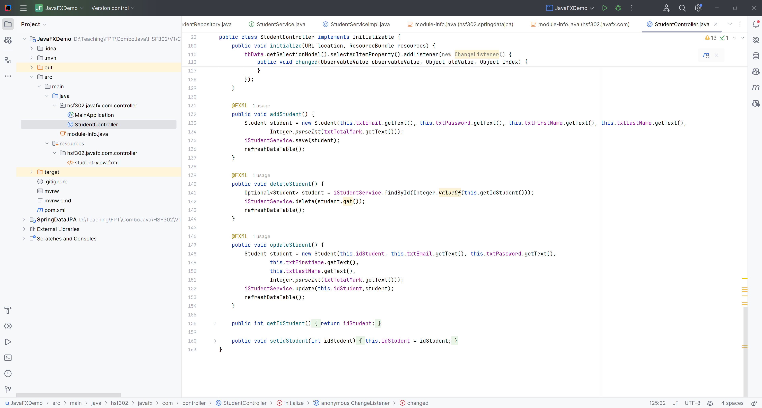
Edit the StudentController.java

Slide 35
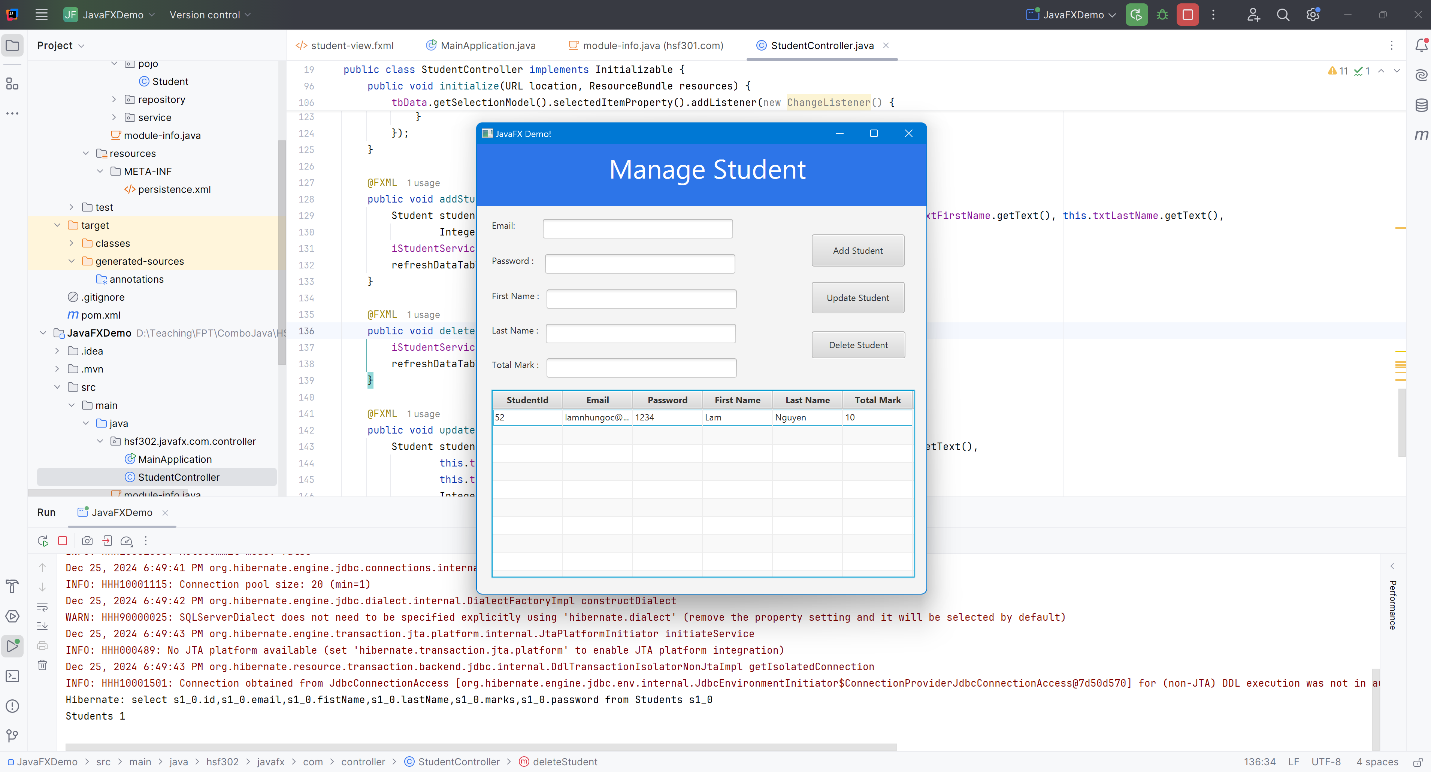
Run Project

Slide 36
Summary
Concepts were introduced:
Implement CRUD (Create, Read, Update, Delete) operations to manage data effectively.
Utilize Hibernate to map Java objects to database tables, simplifying data persistence and retrieval.
Design and develop a user-friendly interface using JavaFX, enabling seamless interaction with the application.
Implement features such as form input validation, error handling, and feedback mechanisms to enhance user experience.

